Slide 1







BUILD
भारत 2.0
WITH
N A T I O N A L L E V E L H A C K A T H O N
TEAM NAME: BYTECODE
P R O B L E M S T A T E M E N T : Privacy-Preserving Agentic HR & Code Review Auditor
TEAM MEMBER: Jitendra Behara, Jitendra Shah, Kumari Soni Gupta, Kirti Kashyap, Manthan
COLLEGE : Lloyd institute of engineering and technology
भा र त 2 . 0

Slide 2

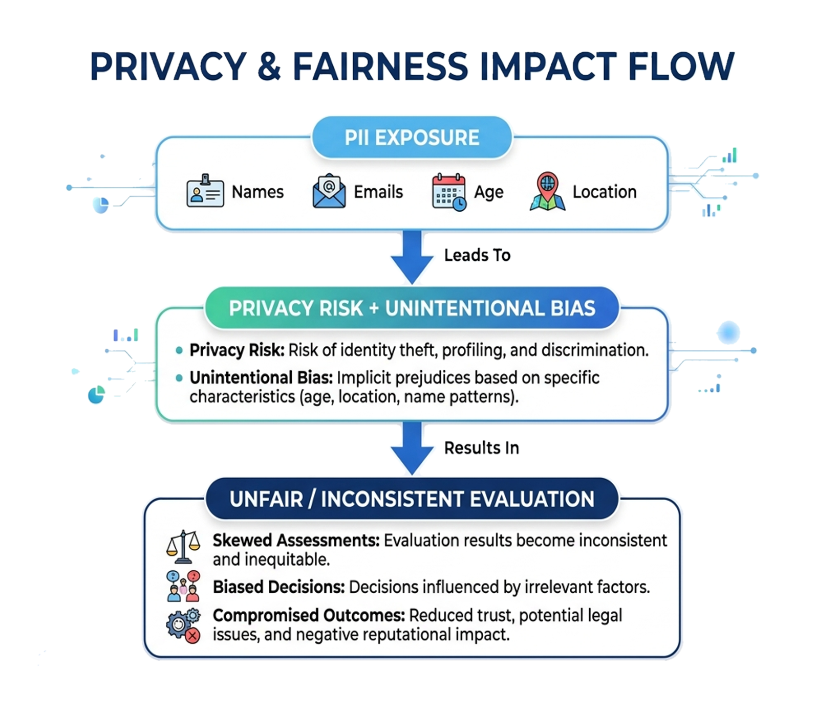
PROBLEM STATEMENT
THE PROBLEM
Modern AI-assisted hiring systems process resumes and code together with personal identity data, creating
Core Challenge
How can we evaluate a developer's skills without letting their identity influence the evaluation?
भा र त 2 . 0

Slide 3
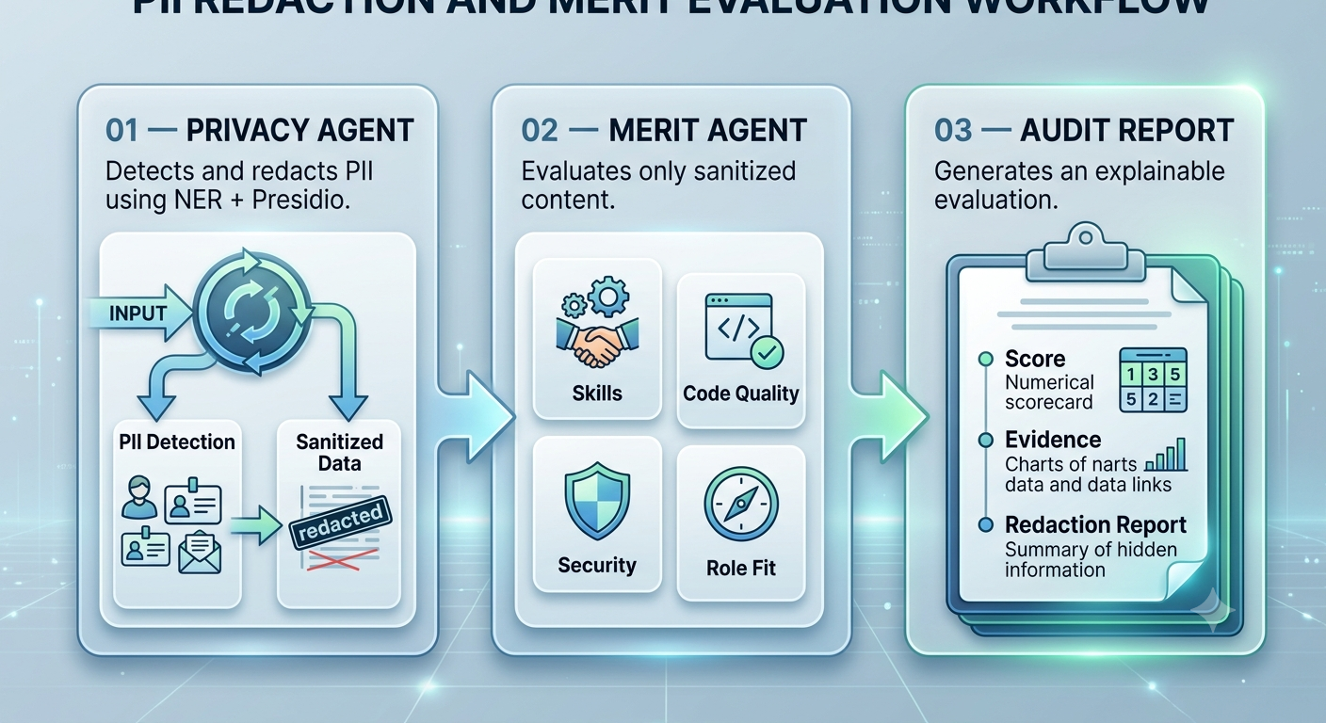
SOLUTION
OUR SOLUTION — VEILAUDIT:
An AI-enabled multi-agent privacy layer that separates identity from merit before evaluation.
Core Principle:
IDENTITY BLIND → MERIT DRIVEN → AUDITABLE
भा र त 2 . 0

Slide 4
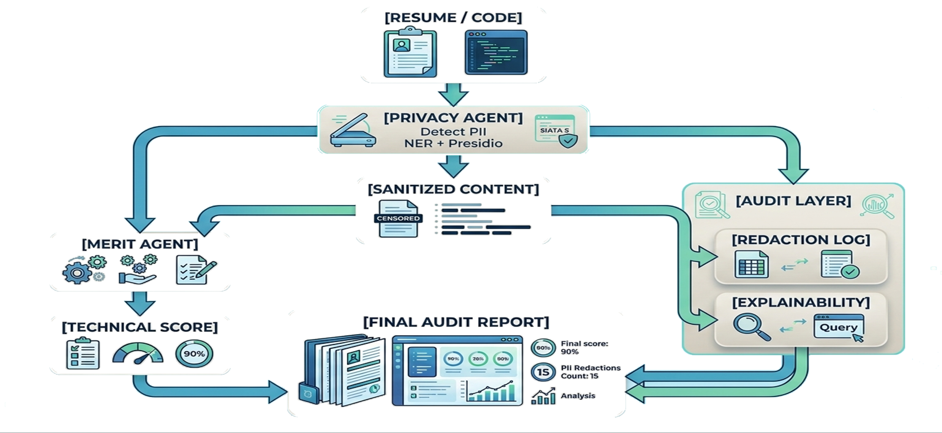
FLOW OF SOLUTION
HOW VEILAUDIT WORKS
Privacy Boundary:
The Merit Agent never receives the original identity-bearing input.
भा र त 2 . 0

Slide 5
TECH STACK
frontend
Html
Css
Javascript
3D interactive interface
AI/NLP
Python
spaCy NER
Local LLM
Secure API
Agent Layer
Privacy Agent
Audit
Explainability layer
AI Model
Groq Cloud
qwen/qwen3.6-27b
Backend
Fast API
PostgreSQL
JWT Auth
pypdf
IMPLEMENTATION APPROACH
Detect → Sanitize → Evaluate → Explain → Audit
भा र त 2 . 0

Slide 6
UNIQUE SELLING PROPOSITION (USP)
WHY
VEILUADIT
WHY
VEILUADIT
WHY
VEILUADIT
🔐 Privacy-First Evaluation PII is removed before merit assessment.
⚖️ Merit-Based Assessment Technical capability becomes the primary evaluation signal.
🔐 Privacy-First Evaluation PII is removed before merit assessment.
🔐 Privacy-First Evaluation PII is removed before merit assessment.
🤖 Multi-Agent Architecture Independent agents handle privacy and evaluation.
🤖 Multi-Agent Architecture Independent agents handle privacy and evaluation.
🤖 Multi-Agent Architecture Independent agents handle privacy and evaluation.
⚖️ Merit-Based Assessment Technical capability becomes the primary evaluation signal.
⚖️ Merit-Based Assessment Technical capability becomes the primary evaluation signal.
WER
🧠 Explainable AI Every score is supported by evaluation criteria and evidence.
💻 Code + Resume Analysis One platform for both developer profiles and technical submissions.
⚡ Local-First AI Sensitive data can be processed locally using an Fast Cloud Inference
KEY INNOVATION
We don't just anonymize the candidate — we architect the evaluation pipeline so the scoring agent doesn't need to know the candidate's identity.
भा र त 2 . 0

Slide 7
FEASIBILITY & COMPETITORS
KEY CHALLENGES
FEASIBILITY
Challenge | Our Approach
PII detection | NER + Presidio
Indirect identity clues | Context-aware sanitization
AI bias | Identity-isolated evaluation
Sensitive data exposure | Local/private inference
Explainability | Evidence-based audit report
Technically Feasible
Deployment
1.Open-source NER & PII detection
2.Local LLM inference
3.Lightweight web architecture
4.Modular agent design
1. Local workstation
2.Private server
2. Secure organizational 3.environment
भा र त 2 . 0

Slide 8

FEASIBILITY & COMPETITORS
COMPETITIVE DIFFERENTIATOR
Traditional ATS
Resume
Screening
AI Code Review
Code
Quality Analysis
Identity
Redaction
Merit Evaluation
Audit
VEILAUDIT

Slide 9
RESEARCH & REFERENCE
भा र त 2 . 0

Slide 10

GUIDELINES
( R E M O V E T H I S S L I D E B E F O R E S U B M I T T I N G Y O U R F I N A L P R E S E N T A T I O N . )
S L I D E | 1 : | C O V E R P A G E ( T E A M N A M E , M E M B E R S , C O L L E G E & P R O B L E M S T A T E M E N T )
S L I D E | 2 : | P R O B L E M S T A T E M E N T
S L I D E | 3 : | P R O P O S E D S O L U T I O N
S L I D E | 4 : | S O L U T I O N A R C H I T E C T U R E / W O R K F L O W D I A G R A M
S L I D E | 5 : | T E C H N O L O G Y S T A C K & I M P L E M E N T A T I O N A P P R O A C H
S L I D E | 6 : | K E Y F E A T U R E S & I N N O V A T I O N
S L I D E 7 : F E A S I B I L I T Y ,
S L I D E 8 : R E F E R E N C E S , G I T H U B R E P O S I T O R Y & D E M O L I N K
C H A L L E N G E S & C O M P E T I T O R A N A L Y S I S
M A X I M U M S L I D E S : 1 0 ( A D D O R R E M O V E S L I D E S I F R E Q U I R E D )
N O T E :
F I N A L
T H I S S L I D E I S F O R G U I D A N C E O N L Y A N D S H O U L D N O T B E I N C L U D E D I N T H E S U B M I S S I O N .
भा र त 2 . 0

